Slide 1
Death Risk Factors Analysis
Group 1
Idean Beheshti
Mai Dang
Jisu Lee
Katie Stewart
(and John Hooser)

Slide 2
Agenda
01
Introduction
Idean Beheshti
02
Data Cleaning
Jisu Lee
03
Visualization
Mai Dang
04
Design & Conclusion
Katie Stewart

Slide 3
Research Questions
01
For each country, which death risk factor had the highest death count?
02
Among the chosen death risk factors, which country had the highest death count?
03
What is the overall death count for each country every year from 1990 to 2019?
04
Visualization of overall dataset distributed by year, death risk factors, age, and countries.

Slide 4
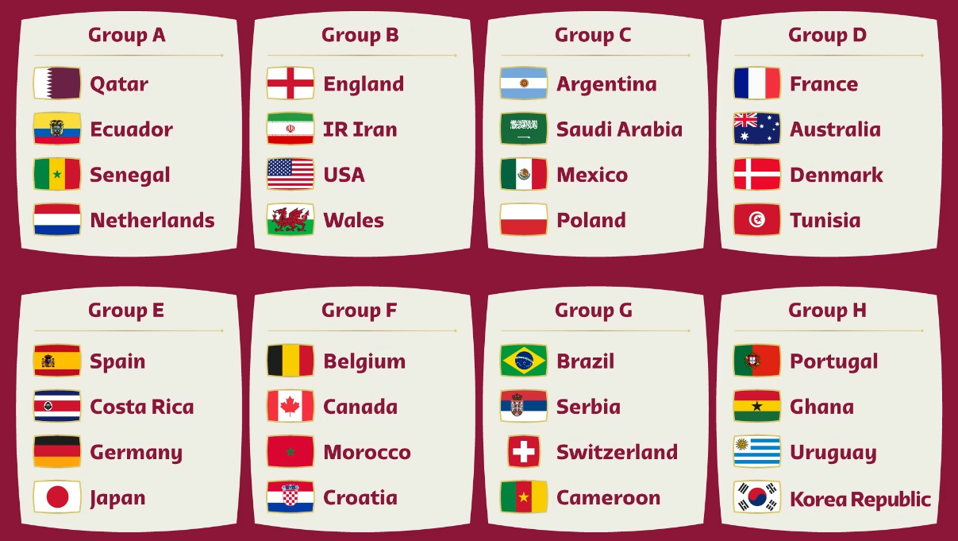
Countries
At least 1 country from each World Cup Qatar 2022 group
At least 1 country from each continent
Picked countries with data from 1990 - 2019

Slide 5


Death Risk Factors
Hypertension (High Blood Pressure)
Causes Irregular heartbeat which can lead to a sudden death
Drug
Causes damage specific organs depending on the drug
Smoking
Causes lung cancer and chronic obstructive pulmonary disease
High Body Mass Index (Obesity)
Causes cardiovascular disease
Alcohol
Causes alcohol poisoning, cancer, heart failure, liver damage

Slide 6
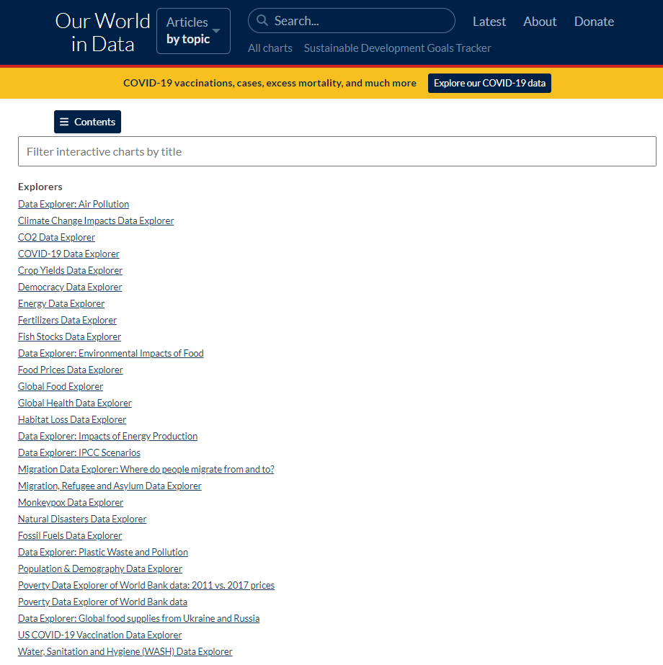
Data
Our World in Data
Oct. 29th
Halloween Tragedy in Korea
Oct. 30th
Morbi Bridge Collapse in India

Slide 7




Design

Slide 8


Sources / References
Data:
https://ourworldindata.org/grapher/deaths-risk-factor-15-49years?time=1990..2019
https://ourworldindata.org/grapher/deaths-risk-factor-50-69years?time=1990..2019
Image:
https://www.fifa.com/fifaplus/en/articles/qatar-2022-all-qualified-teams-groups-dates-match-schedule-tickets-more
Chart:
https://www.chartjs.org/
Design:
https://www.free-powerpoint-templates-design.com/medical-health-care-powerpoint-templates/

Slide 9
THANK YOU

